Slide 1
POINTERS

Slide 2
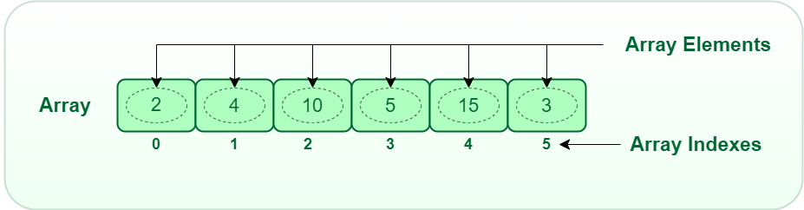
Think about computer memory , a block within memory contains data/values that are of a certain type.
Eg : A 1D array can be visualized with the diagram below as a block of memory divided into smaller chunks and each small chunk holds a piece of data or a value that is a particular type like an int .
int Array[6]={2,4,10,5,15,3}; can be visualized by the diagram below :

Slide 3
Now the array indexes can be thought of addresses .
And these addresses point to a chunk within our block of memory where an element is stored.
So it is safe to say that : for us to access an element or a value stored within our block of memory you need to know its index(address)
Eg. index o points to the location that contains element 2
index 1 points to the location that contains element 4

Slide 4
So a pointer can be defined as :
A special variable that stores the address of memory location where a value is stored.
Remember a variable is a location in memory where a value is stored.
So a pointer will store the address of this variable and inside your variable you store a value.

Slide 5
The syntax of a pointer declaration is as follows :
data_type *pointer_name
The data_type tells us the type of the value stored at the address of our variable
The pointer name has no data type because it just contains an address
Int * points to an integer value
Char * points to a character value

Slide 6
Lets define a variable of type integer named Var1 :
int Var1 ;
Lets assign a value of 100 to our variable :
Var1 = 100 ;
Lets define a pointer named ptr :
int *ptr ;
Lets assign our pointer the address of variable Var1
ptr = &Var1 ;
Now the computer will create a location in memory and name it Var1 and inside this location it will store the value of 100
The computer will automatically assign an address to this location in memory
eg: 0x0123

Slide 7
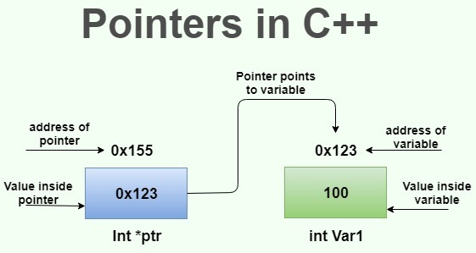

Slide 8
VALUE OF OPERATOR
The value of operator / Indirection operator / Deference operator is an operator used to access the value stored at the location/address the pointer has been assigned to.
Int x=5;
int *ptr ;
ptr = &x ;
printf(“ %d ” , *ptr);
The * means value of operator.

Slide 9
Note : You have to intialise a pointer to use the value of operator.
If you assign a value to an uninitialised pointer , you will get a segmentation error.
This error is caused by a program trying to read or write an illegal memory location.

Slide 10
Pointer Assignment
How to assign content of one pointer to another pointer
eg : int i = 10;
int *p , *q;
p = &i ;
q=p ;
printf(“%d %d” , *p , *q);

Slide 11
Challenge
Create a program with a variable and a pointer and print the address of that variable .

Slide 12
Challenge
Discuss the output of the following program :
int i=20, j=30;
int *p ,*q;
p=&i;
q=&j;
*q=*p;
printf(“%d %d ,p,q);

